Slide 1
Image Compression
Presented by:
Lamyaa El Sayed Yasseen Zayed
“ITI_AI_EPITA”

Slide 2
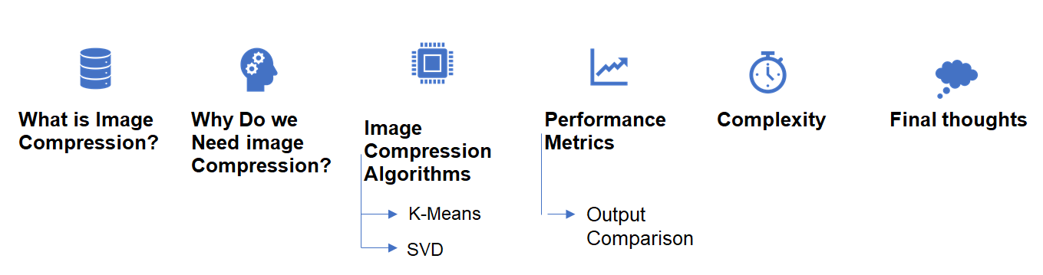
Skelton :

Slide 3
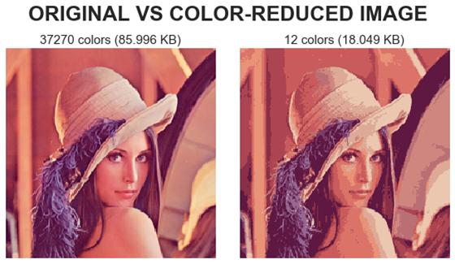
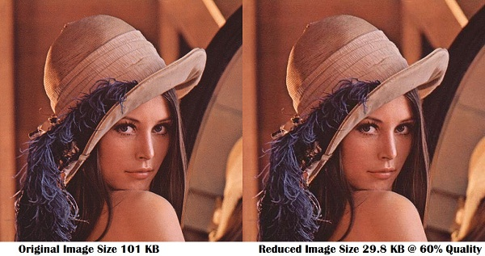
Goal of Image Compression
The problem of reducing the amount of data required to represent a digital image.
Image compression is achieved by eliminating unnecessary data. The changes are made by removing redundant data that are futile and lost during image processing.

Slide 4

Why do We Need Compression?
For data storage and data transmission
DVD, Remote Sensing, Video conference
Image compression is the technique where the size of an image is minimized by keeping the quality of the image to an acceptable level.
The main objective of image compression is to decrease the redundancy of the image thereby increasing the capacity of storage and efficient transmission.

Slide 5
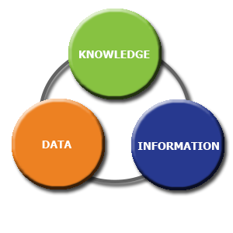
Data ≠ Information
Data and information are not synonymous terms!
Data is the means by which information is transmitted.
Data compression aims to reduce the amount of data required to represent a given quantity of information while preserving as much information as possible.

Slide 6
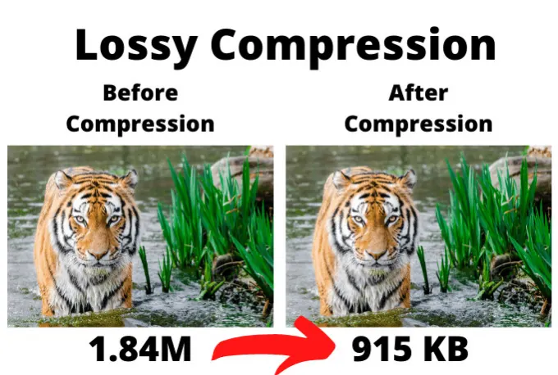
Image Compression techniques:
Lossless:
The compression of a file, all original data can be recovered when the file is uncompressed.
Lossy:
The compressed data is not the same as origins data, but a close approximation of it.

Slide 7
Algorithms for Image Compression:
Algorithms may take advantage of visual perception and the statistical properties of image data to provide superior results compared with generic data compression methods which are used for other digital data.
The effect of the compressed image is evaluated by the reduction ratio of the occupancy and the difference from the original image.
The purpose of image compression is to reduce the space occupied by the image as much as possible while maintaining the similarity with the original image, which is represented by the percentage difference of the image.

Slide 8
Algorithms for Image Compression:
Types of Image Compression Algorithms :
Discrete Fourier Transformation.
K- means.
PCA (Principal Component Analysis).
SVD (Singular Value Decomposition).
Run-length Encoding (Simplest Image).

Slide 9
First Algorithm to present is K-mean:

Slide 10
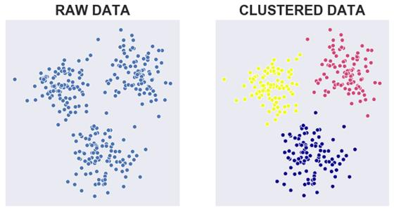
K-means Algorithm for Image Compression:
K-means clustering is a commonly used unsupervised learning algorithm used to divide a data set into k cluster centers, where k must be pre-specified by the user.

Slide 11
K-means Algorithm for Image Compression:
The goal of the algorithm is to classify existing data points into several clusters in order to:
The data in the same cluster is as similar as possible.
The data from different clusters are as different as possible.
Each cluster is represented by the cluster center, which is the average of the cluster data points.

Slide 12
K-means Algorithm for Image Compression:
This is the algorithm:
Number of user-specified clusters k.
Randomly select k different points from the data set as the initial cluster centers.
Assign each data point to the nearest cluster center to which the centroid belongs.
Calculate the new cluster center by taking the average of all data points belonging to the cluster.
Repeat steps 3 and 4 until convergence, that is, the cluster center position remains unchanged.

Slide 13
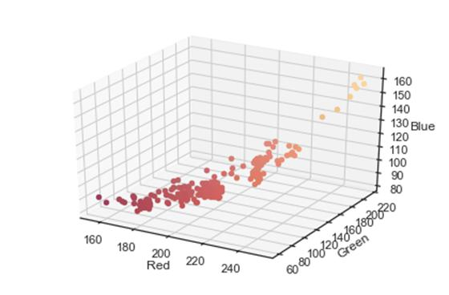
K-means Algorithm for Image Compression:
Idea of k means: Our original image contains thousands of colors. We will use the K-Means clustering algorithm to reduce the number of colors, so it only needs to store a certain number of RGB values.
We will reduce the image size so that it can be stored more efficiently.
We can think of the pixel value as a data frame with (width×height) observation values ​​and three features corresponding to RGB values.
Therefore, we can visualize each pixel in the three-dimensional image.

Slide 14
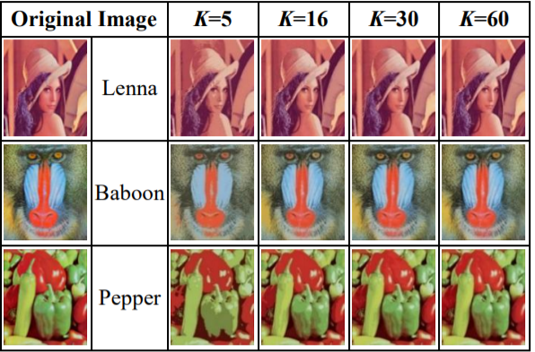
Compressed Images under K Means Clustering Algorithm:

Slide 15
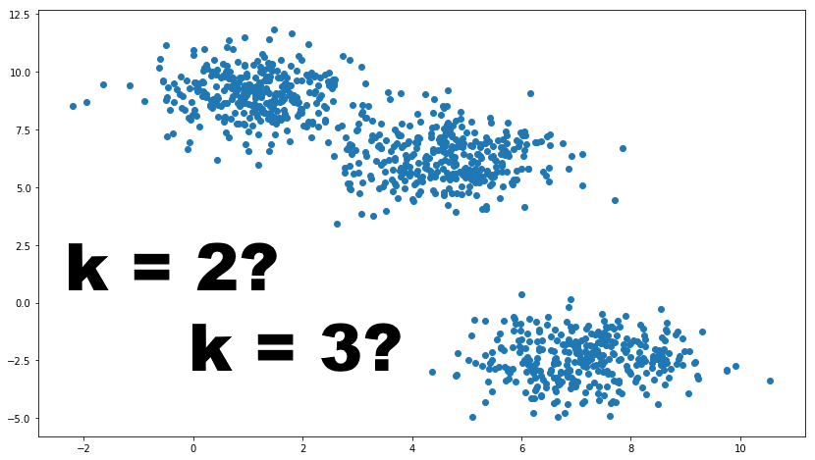
K-means Algorithm for Image Compression:
SELECTING A PROPER K VALUE :
In K-means clustering, selecting the proper K value is one of the most important factors in obtaining an effective performance.
A larger K value means that the classification leads to a various set of colors, thus it provides a higher quality image but low compression .

Slide 16
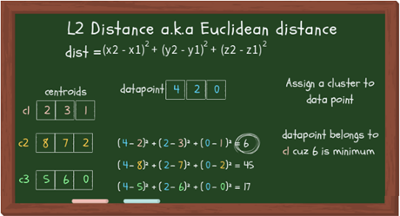
Assigning Clusters to data points:

Slide 17
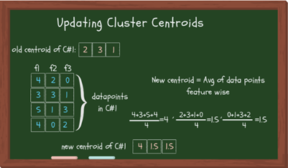
Updating Centroids:

Slide 18
Stopping Criterion:
Like everything else, there are different ways to set the stopping criterion. You can even set multiple conditions that, if met, would stop the iteration and return the results. Some of the stopping conditions are:
The data points assigned to specific cluster remain the same (takes too much time).
Centroids remain the same (time consuming).
The distance of data points from their centroid is minimum (the threshold you’ve set).
Fixed number of iterations have reached (insufficient iterations → poor results, choose max iteration wisely).

Slide 19
Evaluating the cluster quality:
The two methods to measure the cluster quality are described below:
Inertia: Intuitively, inertia tells how far away the points within a cluster are. Therefore, a small of inertia is aimed for. The range of inertia’s value starts from zero and goes up.
Silhouette score: Silhouette score tells how far away the data points in one cluster are, from the data points in another cluster. The range of silhouette score is from -1 to 1. Score should be closer to 1 than -1.

Slide 20
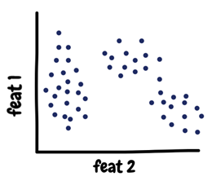
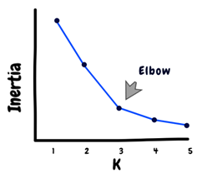
How many clusters?
There are a few methods available to choose the optimal number of K. The direct method is to just plot the data points and see if it gives you a hint.
Other method is to use the value of inertia. The idea behind good clustering is having a small value of inertia, and small number of clusters.
The value of inertia decreases as the number of clusters increase. So, its a trade-off here. Rule of thumb: The elbow point in the inertia graph is a good choice because after that the change in the value of inertia isn’t significant.

Slide 21
Second Algorithm to be presented is SVD:

Slide 22
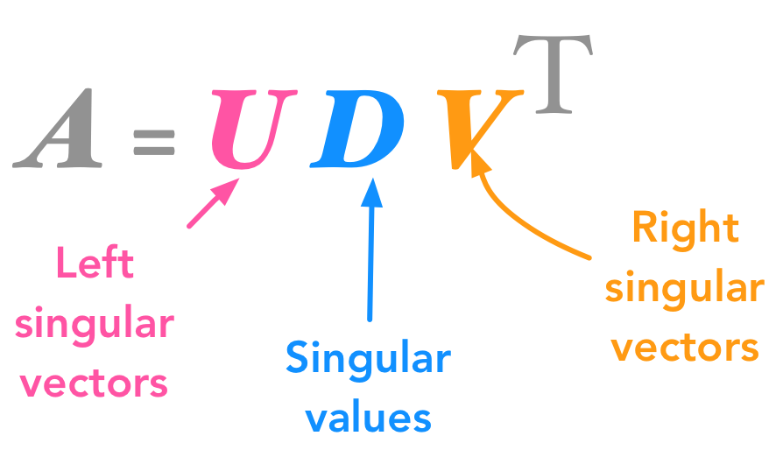
SVD Algorithm for Image Compression:
SVD stands for Singular Value Decomposition,
Basic idea: Taking a high dimensional, highly variable set of data points and reducing it to a lower dimensional space that exposes the substructure of the original data more clearly and orders it from most variation to the least.
Definition: In linear algebra, the singular value decomposition is a factorization of a real or complex, square or non-square matrix. Consider a matrix A with m rows and n columns with rank r. Then A can be factorized into three matrices: A = UDV T

Slide 23
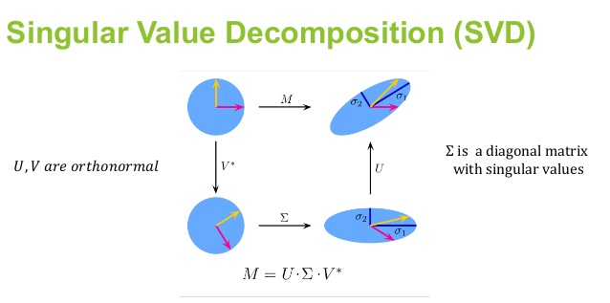
SVD Algorithm for Image Compression:
Why SVD?
Image compression alone can experience redundancies which can be overcome by Singular Value Decomposition (SVD) of the image matrix.
Image compression and coding techniques explore 3 types of redundancies:
Coding redundancy
Interpixel redundancy
Psycho-visual redundancy

Slide 24
SVD Algorithm for Image Compression:
This is the algorithm:
compute AAT and ATA.
Use AAT and A TA to compute Eigenvalues and Eigenvectors to make up the column of U and V.
To form the columns of U and V, divide each Eigen vector by its magnitude.
Calculate the square root of non-zero Eigenvalues and arrange them in the diagonal matrix S in descending order: σ1≥σ2≥σ3 ,…,≥σr ≥0, where r = min (m, n).
Reconstruct the matrix by multiplying U, S and V.

Slide 25
SVD Algorithm for Image Compression:
SVD takes a matrix, square or non-square, and divides it into two orthogonal matrices and a diagonal matrix.
Simply applying SVD on an image does not compress it.
To compress an image, after applying SVD:
Retain the first few singular values (containing maximum image info).
Discard the lower singular values (containing negligible info).
The singular vectors form orthonormal bases, and the important relation:
A vi = si ui

Slide 26
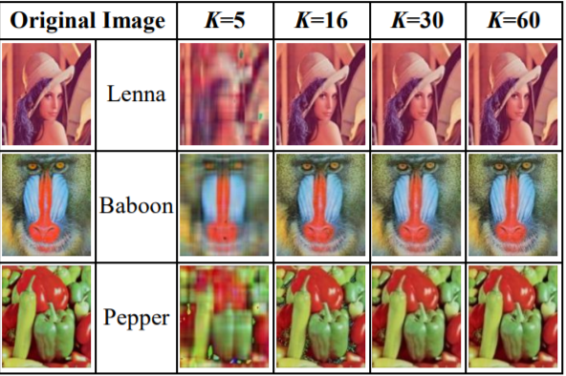
Compressed Images under Singular Value Decomposition Algorithm:

Slide 27
SVD Algorithm for Image Compression:
Observation & Inference:
k represents the number of Eigenvalues used in the reconstruction of the compressed image.
Smaller the value of k, more is the compression ratio but image quality deteriorates.
As the value of k increases, image quality improves (i.e. smaller MSE & larger PSNR) but more storage space is required to store the compressed image.
When k is equal to the rank of the image matrix, the reconstructed image is almost same as the original one.

Slide 28
SVD Algorithm for Image Compression:
SVD applications in world of image and data compression are very useful and resource-saving.
SVD allows us to arrange the portions of a matrix in order of importance.
The most important singular values will produce the most important unit eigenvectors.
We can eliminate large portions of our matrix without losing quality.
Therefore, an optimum value for 'k' must be chosen, with an acceptable error, which conveys most of the information contained in the original image, and has an acceptable file size too.

Slide 29
Comparison between the two Algorithms:

Slide 30
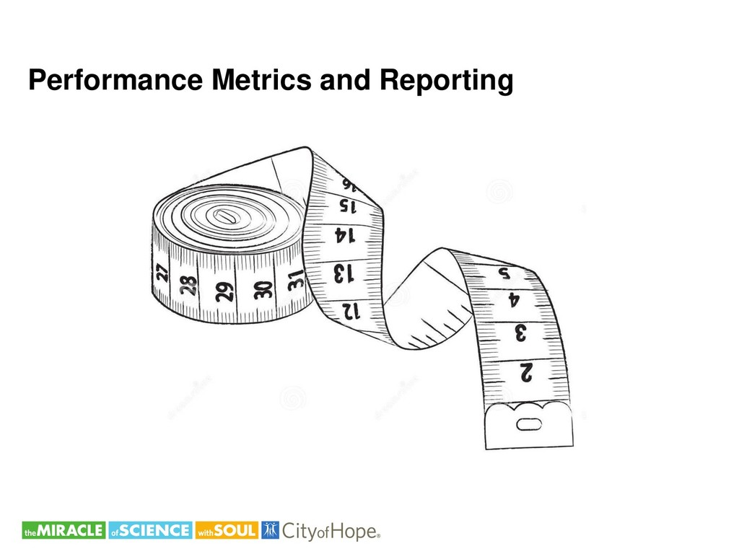
Performance Matrix:
Is a meaningful and computable measure used for quantitatively evaluating the performance of any algorithm.

Slide 31
Performance Matrix Parameters:
Compression ratio(CR) :
Ratio between the uncompressed size and compressed size.
MSE (Mean Squared Error):
Represents the cumulative squared error between the compressed and the original image, the lower the value of MSE, the lower the error.
PSNR (Peak Signal to noise ratio):
Represents a measure of the peak error. The higher the value of PSNR, the lower the error.
RMSE (Root Mean Squared Error):
The square root of the average of squared errors. larger errors have a disproportionately large effect on RMSE. sensitive to outliers.

Slide 32
Performance Matrix Parameters:
EGRAS(Relative Global Error):
Calculates a dimensional global relative error of synthesis (ergas).
SAM(spectral angle mapper):
Spectral classification that uses an n-D angle to match pixels to reference spectra(Lower SAM better Quality)
UQI(universal image quality index):
Modeling any image distortion as a combination of three factors: loss of correlation, luminance distortion and contrast distortion.(lower UQI better Quality)
VIFP(Visual Information Fidelity):
Predict visual quality by comparing a distorted signal against a reference, typically by modeling the Human Visual System (HVS).

Slide 33
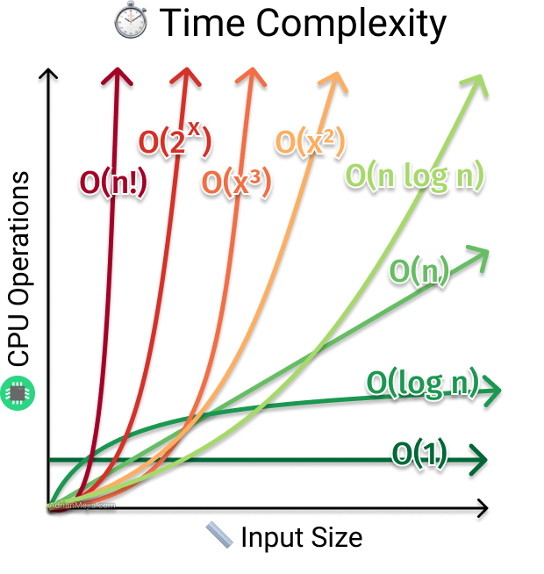
What is Time Complexity and Why it is important?
Time Complexity is the total amount of time taken to execute a piece of code.
This piece of code could be an algorithm or merely a logic which is optimal and efficient.
Time complexity is a measure that determines the performance of the code which thereby signifies the efficiency of the same.

Slide 34
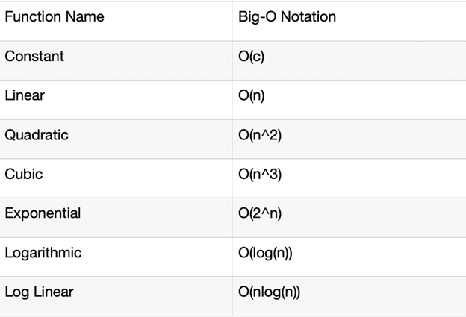
What is Big-O?
Big-O notation signifies the relationship between the input and the code, and some of the common Big-O functions are as follows:

Slide 35
Time Complexity for K-mean Algorithm:
The k-means algorithm is have a time complexity of O (n2), where n is the input data size.
The parameter of complexity is (T ,K, n), where n is the number of input patterns, K is the desired number of clusters, and T is the number of iterations needed to complete the clustering process.
The clustering complexity can also be expressed as a product of iteration complexity and distribution complexity, that is,
O (Clustering) = O (Iteration) × O (Distribution) = O (T) × O (D).
if k and d (the dimension) are fixed, the problem can be exactly solved in time , where n is the number of entities to be clustered. O(n^(dk+1))

Slide 36
Time Complexity for SVD Algorithm:
in image compression. The complexity is in O(min(mn^2,m^2 n)).
At a glance, it is considered as: O(T(|A|k+k^3+c))
T is # of iterations, |A| is # of non-zeros in the input sparse matrix A,
k is the target number of the largest singular values, and
c is the other computational cost for each step.
Note that this might be wrong since it is roughly estimated based on sparse matrix multiplication and QR decomposition.
If k is not small enough, svds performs full svd based on sparseQR.
SVD Time Comlexity O(mn^2) or O(m^2n) (Minimum of them)

Slide 37
Comparison between K-mean and SVD on our Model:
K-mean Algorithm | SVD Algorithm
CR: compression ratio of k-means 32 colors = 20% MSE: Mean Squares Error = 39.2146322074795 PSNR: Peak Signal to Noise Ratio = 32.19632214733868 RMSE: root mean squared error = 6.262158749782658 | CR: compression ratio of SVD 32 colors = 12%(compressed/original) MSE: Mean Squares Error = 76.03353627522787 PSNR: Peak Signal to Noise Ratio = 25.674849474183688 RMSE: root mean squared error = 13.267763047146564

Slide 38
Comparison between K-mean and SVD on our Model:
K-mean Algorithm | SVD Algorithm
EGRAS: global relative error = 2349.1385043274045 REF_SAM: spectral angle mapper = 0.048586090630173884 UQI: universal image quality index = 0.9973239283444323 VIFP: Pixel Based Visual Information Fidelity = 0.4702669880358812 | EGRAS: global relative error = 4218.320375273305 REF_SAM: spectral angle mapper = 0.10005702157653669 UQI: universal image quality index = 0.9869950187830524 VIFP: Pixel Based Visual Information Fidelity = 0.2696798072140701

Slide 39
Conclusion:
Image compression is an essential requisite for today’s digital lifestyle due to the proliferation of large image files across all media.
The techniques proposed and enumerated by the preceding parts of this presentation certainly accomplish the task of compressing the size of image files in an efficient manner.
As evident from the discussions delineated above, we can observe that, if the K value is smaller, the compression rate in both the algorithms are higher.
By analysing and comparing these two algorithms we can see that the output is better in the K Means Clustering Algorithm with lower K value.
These techniques can be used for both personal and business purposes.
Comparative analysis of both the two considered algorithms with other existing techniques shall help to identify the efficient method.

Slide 40


